Slide 1
Reinforcement Learning Tutorial
(Group-5)
Dharan Kunati
Venkata Brahmini Ramasani
Nikhila Narla
Anitha Nari
Harshitha Ambilpur
Venkata sai chandrika gudipati
Surya Chandra Reddy

Slide 2
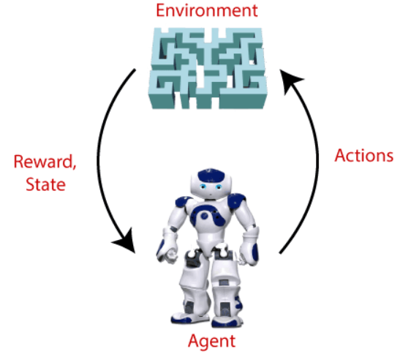
What is Reinforcement Learning?
Type of machine learning method where an intelligent agent (computer program) interacts with the environment and learns to act within that.
Solves a specific type of problem where decision making is sequential, and the goal is long-term, such as game-playing, robotics, etc.
The agent learns that what actions lead to positive feedback or rewards and what actions lead to negative feedback penalty. As a positive reward, the agent gets a positive point, and as a penalty, it gets a negative point
Terms used in Reinforcement Learning:
Agent(), Environment(), Action(), State(), Reward(), Policy(), Value(), Q-value()

Slide 3
Key Features of Reinforcement Learning
hit and trial process
The agent is not instructed about the environment and what actions need to be taken.
The agent may get a delayed reward.
The environment is stochastic, and the agent needs to explore it to reach to get the maximum positive rewards.
Approaches to implement Reinforcement Learning
Value-based
Policy-based - The policy-based approach has mainly two types of policy:
Deterministic
Stochastic
Model-based

Slide 4
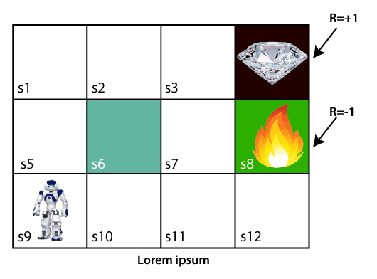
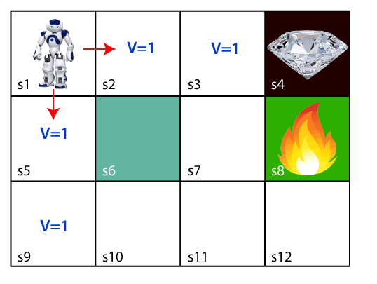
Working of Reinforcement learning
To understand the working process we need to consider:
Environment: It can be anything such as a room, maze, football ground, etc.
Agent: An intelligent agent such as AI robot.
In the below image, the agent is at the very first block of the maze. The maze is consisting of an S₆ block, which is a wall, S₈ a fire pit, and S₄ a diamond block.
The agent will try to remember the preceding steps that it has taken to reach the final step. To memorize the steps, it assigns 1 value to each previous step.
It will be a difficult condition for the agent whether he should go up or down as each block has the same value. So, the above approach is not suitable for the agent to reach the destination. Hence to solve the problem, we will use the Bellman equation, which is the main concept behind reinforcement learning.

Slide 5
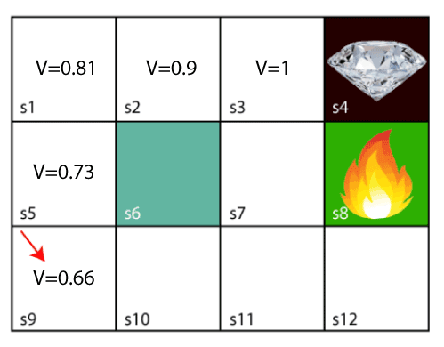
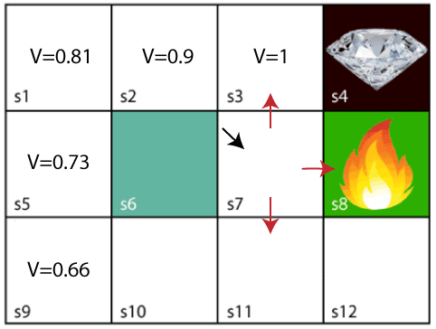
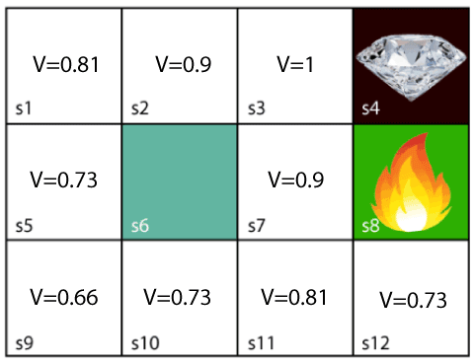
BELLMAN EQUATION
To solve the above problem, we use the bellman equation.
The key-elements used in Bellman equations are:
Action performed by the agent is referred to as "a"
State occurred by performing the action is "s."
The reward/feedback obtained for each good and bad action is "R."
A discount factor is Gamma "γ."
The Bellman equation can be written as: V(s) = max [R(s,a) + γV(s`)]

Slide 6
Elements of Reinforcement Learning
There are four main elements of Reinforcement Learning, which are given below:
Policy:A policy can be defined as a way how an agent behaves at a given time. It maps the perceived states of the environment to the actions taken on those states.
For deterministic policy: a = π(s)
For stochastic policy: π(a | s) = P[At =a | St = s]
Reward Signal:The goal of reinforcement learning is defined by the reward signal. At each state, the environment sends an immediate signal to the learning agent, and this signal is known as a reward signal.
Value Function:A reward indicates the immediate signal for each good and bad action, whereas a value function specifies the good state and action for the future.
Model of the environment:The approaches for solving the RL problems with the help of the model are termed as the model-based approach. Comparatively, an approach without using a model is called a model-free approach.

Slide 7
Reinforcement Learning Algorithms
Mainly used in AI applications and gaming applications
Q -learning: Used for the temporal difference Learning. It learns the value function Q (S, a), which means how good to take action "a" at a particular state "s."
State Action Reward State action (SARSA): calculate the Q π (s, a) for the selected current policy π and all pairs of (s-a)
Deep Q Neural Network (DQN): Instead of defining a Q-table, neural network approximates the Q-values for each action and state.

Slide 8
Markov Decision Process
To formalize the reinforcement learning problems.
The agent constantly interacts with the environment and performs actions; at each action, the environment responds and generates a new state.
MDP contains a tuple of four elements (S, A, P_{a}, R_{a}):
A set of finite States S
A set of finite Actions A
Rewards received after transitioning from state S to state S', due to action a.
Probability P_{a}.
Markov Property:
The current state transition does not depend on any past action or state.
Eg; Chess game , the players only focus on the current state and do not need to remember past actions or states.

Slide 9
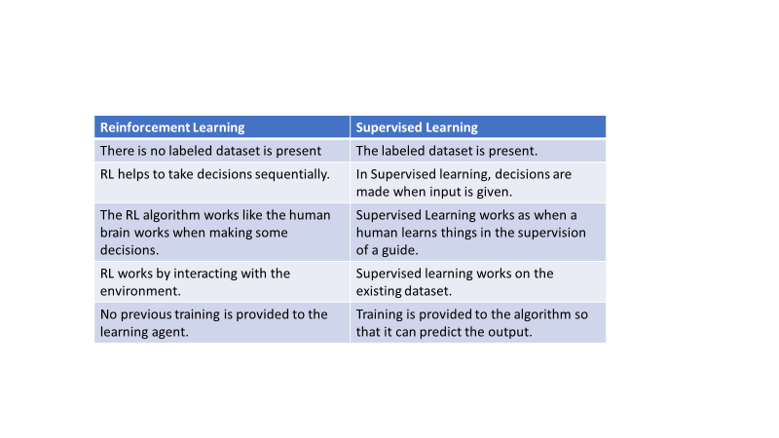

Slide 10
Application of Reinforcement learning:
Robotics- Robot Navigation
Game Playing- Chess, Tic-tac-Toe
Business strategy Planning
Optimizing Chemical reactions
Auto-mobile Manufacturing Industry
Evaluation of Trading strategies in Finance Industries.

Slide 11
Conclusion
Reinforcement is the important and useful part of Machine Learning
The Agent() explores and validates the application environment without any Human support.
This what makes the base for the Artificial Intelligence Algorithms.
One of the major problem of Reinforcement learning is the effect of some Parameters like delayed feedback on the speed of learning.
Too much of reinforcement techniques may lead to overloading of states which further damages the final results.

Slide 12
THANK YOU

